Slide 1


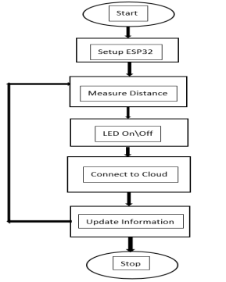
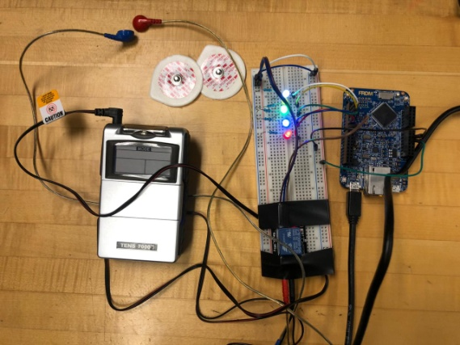
Inventory Automation Using Electronically Connected Intelligent Shelves
Priyank Kalgaonkar, Sahil Kumar, Linknath Balasubramanian
ECE 53301 Professor: Mohamed El-Sharkawy
Introduction
Software Workflow
Conclusions
The Electronically connected intelligent shelves(ECIS) system uses a microcontroller unit,ultrasonic sensors and IOT server. The main objective of the inventory automation using Electronically connected intelligent shelves project is to reduce loss in revenue due to delayed shelf restocking(when product is in stock in the store but not stocked on the shelf) and inaccurate forecasting(under-estimating future product sales) practices. the result is to demonstrate this idea of inventory automation using ECIS system by enabling the means to monitor and track store inventory in real-time,perform data analysis remotely in cloud,improve shopping experience for the consumers and increase revenue for the retailers in the retail industry.
We are monitoring the product availability on the shelf throughout the day
We are alerting the warehouse associates prior to shelf gets empty
Enhances the shopping experience for consumers
We are generating a graphical information for data analytics and research
System Setup
Hardware Requirement
Software Requirement
For attaining the desired output we have programmed the FRDM-K64f board using the Mbed compiler as the main IDE
For the data analytics,we are sending data to cloud using the ESP 8266 WIFI module
Provided the data from cloud server ,we can do the machine learning and can predict future sales
1. FRDM-K64F
2. ESP8266 WIFI MODULE
3. HC-SR04 ULTRASONIC SENSORS
4.Jumpeir Wires
5.Breadboard

